Slide 1
Networked Radiation Sensor
Sawaiz Syed, Dr. Xiaochun He

Slide 2
Hardware
Microcontroller – AVR AtTiny 13A/2313
Sensor – Gieger Muller Tube, 400-500 VDC
Power – 3.7V Li-ion cell, ~2 AH
Wireless Communication - NRF24L01+
Polycarbonate/ABS Injection molded casing

Slide 3
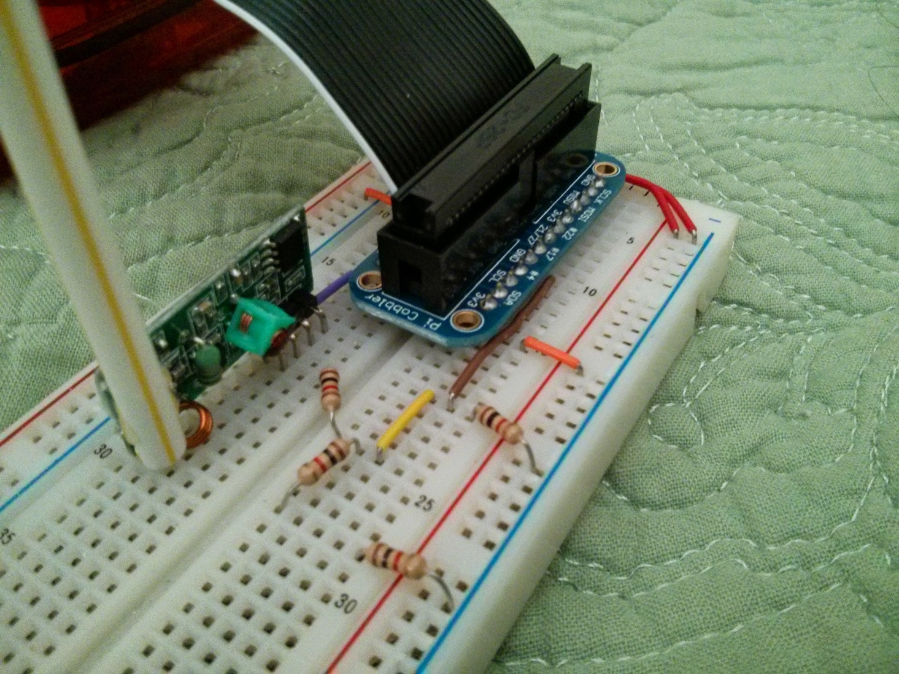
Current Prototype
AVR Transmitter with 433MHz
Arduino Transmitter with 433MHz
Arduino server 433MHz
Raspberry Pi Server 433Mhz

Slide 4
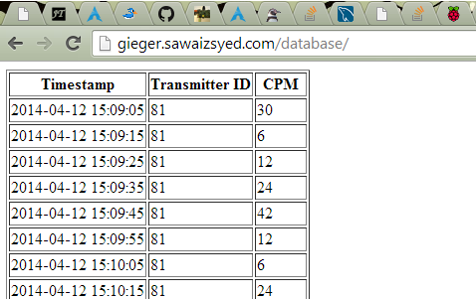
Raspberry Pi DB
The raspberry pi is able to log data directory into a database that is accessible via its webserver.

Slide 5
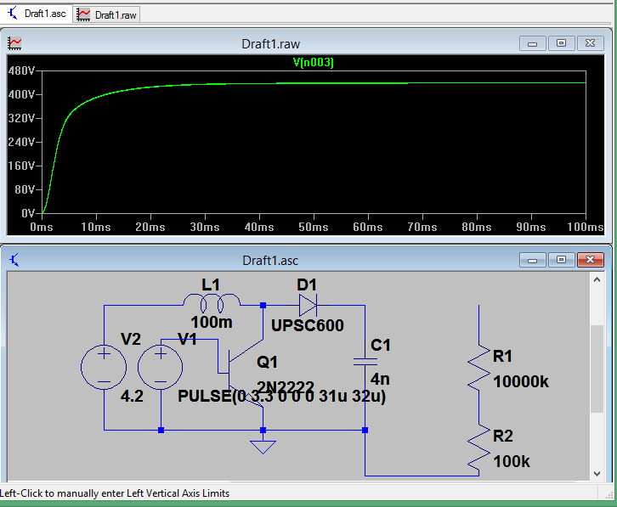
Current progress
HV Supply
NRF24L01+
More reliable Wireless module
About $2 produced cost
Two way communication
Libraries available

